Slide 1
Dispelling Development
Exploring myths as meaning making systems
Fawzia Haeri Mazanderani
PhD Researcher at the University of Sussex
mazanderani121@gmail.com

Slide 2
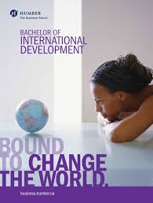
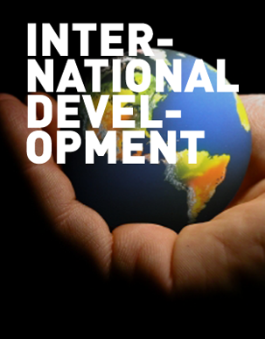
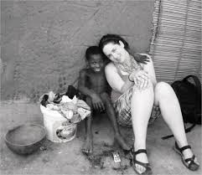

Slide 3
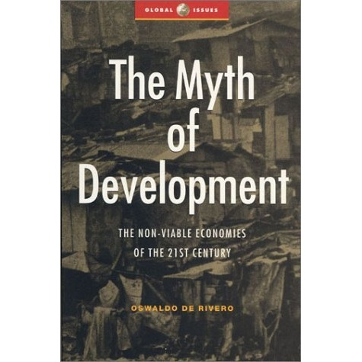
A paradox at play
‘There has been an international rise in Development Studies’ (Tribe, 2009)
‘Despite huge sums of money that have been invested in development projects, the vast majority of these projects are viewed by many academics as ‘unremitting failures’ (Ferguson, 1990).
Despite this, students who study development often have a continued interest in pursuing work within the development sector.

Slide 4
Making sense of myth
‘A widely held but false belief or idea’ – Oxford English Dictionary
‘Myth is symbolic, not literal truth. We judge a myth the way we judge a poem or by a painting, by its power to move us emotionally, to challenge or reassure us intellectually, to shape, reshape, or reaffirm the way we experience the world’ – Ira Chernus

Slide 5
Defining development
Actions which are intended ‘to move societies and people from a situation in which they are believed to be worse off, to situations in which they are assumed to be better off’ (Barbanti, 2004).
‘Divergent and evolving interpretations’ of what development means (Kothari and Minogue, 2002).

Slide 6
The development of development
Against the backdrop of World War 2, development appeared as a new ‘vision of hope’
Critics argue that development provides alternative, but no less sinister, mechanisms of maintaining power relations between the ‘developed’ and ‘developing’ worlds, serving as ‘an instrument of economic control produced by the “first” world over the “third”’ (Escobar, 1995).

Slide 7
Academic critiques of development:
The ‘success’ of development lies in the fact that it is ‘not objectively verified but socially produced’ (Mosse, 2005).
The notion of ‘failure’ serves to justify further work because, by recognising ‘how much still has to be done’, the solution simply becomes ‘more development’ (Tania Li, 1999).
Development is the ‘new religion of the west’

Slide 8
Methodology
Man is always a storyteller! He lives surrounded by his and others’ myths. With them he sees everything in life, no matter what befalls him. And he seeks to live his life as though he were telling it’
Sartre (cited in Gergen and Gergen, 1983: 254)
Semi-structured in-depth interviews with eight students at SOAS
Studying either Development Studies or Anthropology of Development
Mixed group
Different academic/professional stages
Equal gender split
Predominantly British participants

Slide 9
Three stages of analysis
Enchantment
Key motivating factors which have caused individuals to pursue studies within this field
Disenchantment
Emerging in line with a critical academic overview of development
Re-enchantment
An awareness of the complexities of development enables a justification to pursue work in this field

Slide 10
Enchantment
Development has become one of the ‘cognitive binding forces that hold the global system together’ (Johnston, 1991).
Gap years
Adventure!
Europe has created an ‘oriental place’ of ‘romance, exotic beings, haunting memories and landscapes, remarkable experiences’ (Said, 1978).

Slide 11
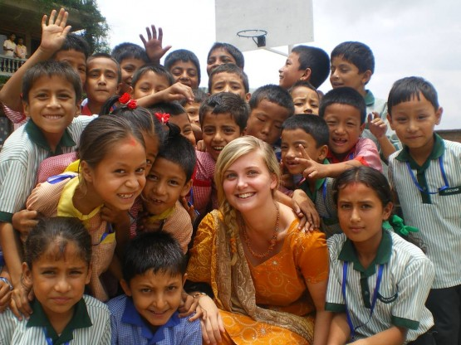
Enchantment
“We need myths that will identify the individual not with his local group but with the planet.” Joseph Campbell, The Power of Myth

Slide 12
Desire to ‘make a difference’
An understanding of development is not a trans-historical, universal phenomena but inseparable from the specific historical and social context from which it has emerged (McNay, 2007)
Sensationalistic portrayals of development are omnipresent, serving to ‘attract attention, galvanise support and direct practice’ (Crewe and Axelby, 2013).
An enticing myth?

Slide 16
Disenchantment
Development as ‘a chaotic multinational enterprise experiencing great difficulty and open to all out critique’ (Giri et al, 2003).
‘Not living up to expectations’
A feeling of helplessness
‘Critique after critique after critique’
The myth is destroyed?

Slide 17
Re-enchantment
Personalised justifications
Critiques of development are appropriated and reconfigured in order to inform, justify and strengthen actors’ motivations to pursue work within the field.
Students retain a ‘belief’ in development, as they perceive their ability to engage in development to contain ‘a certain order of meaning’ (Geertz, 1973: 27-55).
Students concerns with the ‘unremitting failures’ (Ferguson, 1990) of development are outweighed by a perception of their own potential as subjects who can ‘act in the world’ (Moore, 1994: 118).

Slide 18
Dreams to live by
Motivations to study development express, in Foucault’s terms, a ‘care for the self,’ although this is primarily justified through students’ narratives as a ‘care for the other’ (1984).
The ‘myth’ of development retains a function.
‘Myths help us deal with reality, they are tales to live by. They are the dreams of the world’ – Joseph Campbell

Slide 19
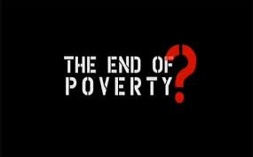
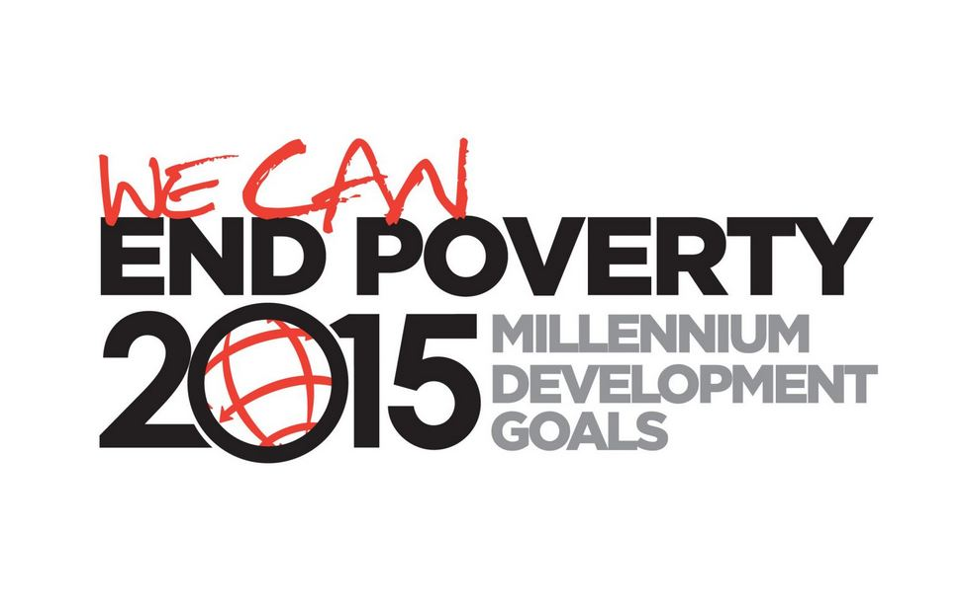
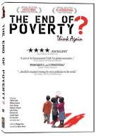
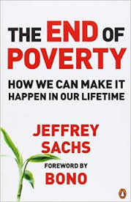

Slide 20
References:
Barbanti, O (2004), ‘Development and Conflict Theory,’ Accessed via beyondintractability.org on 28/08/2013
Crewe, E and Axelby, R (2013), ‘Anthropology and Development: Culture, Morality and Politics in a Globalised World,’ Cambridge: Cambridge University Press.
Escobar, A (1995), ‘Encountering Development: The Making and the Unmaking of the Third World,’ Princeton University Press, Princeton, NJ.
Ferguson, J (1990), ‘The Anti-Politics Machine: Development, Depoliticization and Bureaucratic Power in Lesotho,’ Cambridge University Press, Cambridge.
Foucault, M (1984), ‘The ethic of care for the self as a practice of freedom: An interview with Michel Foucault,’ January 20, 1984 in Bernauer, J and Rasmussen, D (eds.) (1987), ‘The Final Foucault,’ MIT Press.
Geertz, C (1973), ‘Religion as a Cultural System,’ in the ‘Interpretation of Culture,’ New York: Basic.
Gergen, K and Gergen, M (1983), ‘Narratives of the self,’ in ‘Studies in Social Identity,’ New York, Praeger.
Giri, A. K. and Quarles Van Ufford, P (eds)(2003), ‘A Moral Critique of Development: In search of Global responsibilities,’ Routledge, London.
Kothai and Minogue (eds.) (2002), ‘Development theory and practice: critical perspectives,’ Palgrave.
Li, T (1999), ‘Compromising Power: Development, Culture, and Rule in Indonesia,’ Cultural Anthropology, Vol. 14, No. 3, Aug, 1999.
McNay, L (2007), ‘Against Recognition,’ Polity Press.
Moore, H (1994), ‘A passion for difference: essays in anthropology and gender’, Polity Press.
Mosse, D (2005), ‘Cultivating Development: an Ethnography of Aid Policy and Practice,’ London: Pluto Press.
Rist, G (1990), ‘Development as the new religion of the West’, Quid Pro Quo 1 (2), pp 5–8.
Said, E (1979), ‘Orientalism,’ New York: Vintage Books.
Tribe, M (2009), ‘A short history of the Development Studies Association,’ Accessed via http://www.devstud.org.uk/downloads/4b28d5cf9a404_DSA_History_January-2009-draft_ver9-web.pdf on 28/08/2013

